Slide 1
Kashmiri Culture
Speakers:
Hassaan Anwar (22P-9160)
Hamza Shahid (20P-0117
Inayat Ullah(20P-0487))

Slide 2
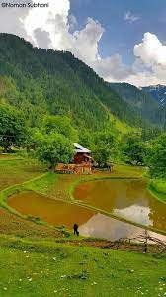
Introduction
Located In The North Of Pakistan
Immense Natural Beauty
Agricultural Region
Main Language Of Kashmiri
Skilled Handcrafts
Notes:
Kashmiri culture is a vibrant and diverse aspect of the country's cultural heritage. Located in the north of Pakistan, the region is known for its immense natural beauty, with breathtaking mountain ranges, tranquil lakes, and lush green valleys. It is an agricultural region, with farming being the main occupation of the people. The main language spoken in the region is Kashmiri, which has its own unique script and is a significant part of the cultural identity of the people. Kashmiri culture is also renowned for its skilled handcrafts, including intricate embroidery, woodcarving, and weaving, which have been passed down through generations. The fusion of natural beauty, rich agricultural practices, unique language, and exquisite handcrafts makes Kashmiri culture a captivating and fascinating aspect of the country's diverse cultural landscape.

Slide 3
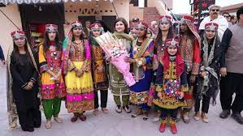
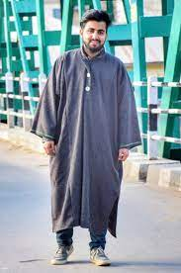
Ethnicity
Indo-European Ethno-Linguistic Ethnicity
Rich Heritage: Music, Dance And Cuisines
Pheran Traditional Dress With Koshur Topi
Main Language Of Kashmiri Or “Koshur”
Notes:
"Indo-European Ethno-Linguistic Ethnicity" means a group of people who share a common language and culture that evolved from a common ancestral language called Proto-Indo-European. This group of people is found across Europe, western and southern Asia, and parts of the Indian subcontinent.
Kashmiri culture has a rich heritage with music, dances and delicious cuisines.
Pheran is a traditional dress that is worn by both the men and women in Kashmir. This was very common until recently, when people started to wear the more common salwar kameez. Kashmir’s main language is known as Kashmiri, also known as Koshur. A lot of people speak this but they are also multilingual, being able to speak languages such as Urdu and English

Slide 4
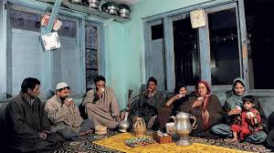
Cultural Shocks
Values: Hospitality And Respect
Collectivistic: Group Harmony And Interdependence
Social Class:
Upper: Syeds, Pirs, Ulemas And Sheiks
Lower: Dom and Wattals
Notes:
Cultural Shocks:
Kashmir has its own customs, values and traditions that can be overwhelming for outsiders. They have been heavily influenced by central Asian and Persian cultures. They are also very fond of meat and tea, especially in the afternoon.
Values:
Kashmiri culture has strong values of hospitality, respect and community.
Collectivistic Culture:
Kashmiri culture is primarily collectivistic, emphasizing group harmony and interdependence over individual goals and autonomy.
Social Class:
Kashmir has a threefold social class. The upper class are: Syeds, Pirs, Ulemas and Sheiks while the lower class are: Dom and Wattals while the rest are middle class.

Slide 5

Intercultural Communication
Tourist Hotspot
Very Good Interculturally
Strong Code-Switching
High Context Culture
Notes:
Intercultural Communication:
As Kashmir is a very popular tourist destination, the people of Kashmir are very good at intercultural communication. They can usually communicate in multiple languages such as: Kashmiri, Urdu and English.
Code Switching:
Kashmiri culture is rather good at code switching as even though its main language is Kashmiri, people of Kashmir also speak Urdu and English.
High Context Culture:
Kashmiri culture is a high context culture as non verbal communication plays a key part in getting information to the other person.

Slide 6
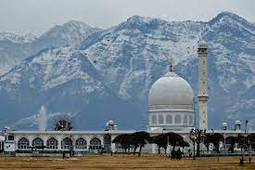
Dominant Culture
Kashmiri: Heavily Influenced By Islam
High Uncertainty Avoidance Culture
High Power Distance Culture
Masculine Culture
Polychronic Culture
Notes:
Dominant Culture / Religion:
Kashmir’s dominant Kashmiri culture is heavily influenced by the religion of Islam as it is the predominant religion in the area. Most people strictly follow this religion.
High Uncertainty-Avoidance Culture:
The Kashmiri culture tends to be high uncertainty-avoidance, emphasizing structure and stability in daily life. They want to make their daily lives as stable as possible.
High Power Distance Culture:
Kashmiri culture is a high power distance culture as the distribution of power between different social classes, mainly based on culture, is relatively high. This leads to strong differences in the social classes of different cultures.
Masculine Culture:
Kashmiri culture is a masculine culture as gender roles are strongly enforced. Males play the more traditional outdoor role while women usually play domestic roles, although significantly lesser than in the near past.
PolyChronic:
Kashmiri culture is mostly polychronic as maintaining good relationships is a vital part of their daily lives. This can be referred back to their fundamental values of hospitality and friendliness

Slide 7
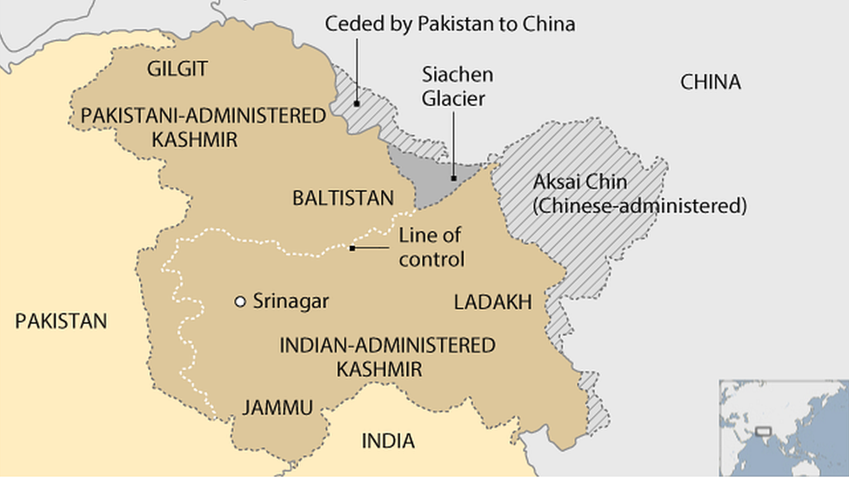
Co-Cultures
Many Religious Co-Cultures
Hinduism
Sikhism
Mostly Live In Harmony
Friendly With Each Other
Notes:
Co-Cultures:
Even though Kashmiri culture is heavily based on Islam, there are some co-cultures that exist which have their own unique traditions. Like the dominant culture, these co-cultures are also usually based on their own religion such as Hinduism and Sikhism.
The dominant culture lives peacefully with the co-cultures and they express strong expressions of friendliness towards each other. This is mainly because of their values of hospitality and love.

Slide 8
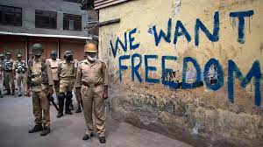
Ethnocentric Culture
High Cultural Pride
Koshur As Their Best Language
Conflict May Cause The Belief Of Superiority Of Kashmiri Culture
Notes:
Ethnocentrism:
In the context of Kashmiri culture, ethnocentrism has played a significant role in shaping the attitudes and beliefs of the Kashmiri people. Kashmiri culture is rich and diverse, with a long history of artistic, literary, and intellectual achievements. However, this cultural pride and sense of identity can sometimes lead to a tendency to view other cultures and ethnicities as inferior.
For example, the Kashmiri language is an important aspect of Kashmiri culture and identity, and some Kashmiris may view other languages as less important or less worthy of recognition. Similarly, there can be a tendency to view people from outside the Kashmiri ethnic group as outsiders or even as threats to Kashmiri identity.
Ethnocentrism can also manifest in political attitudes, particularly with regards to the ongoing conflict over the status of Kashmir. Some Kashmiris may view other ethnic groups, particularly those from India or Pakistan, as threats to Kashmiri sovereignty and cultural identity.

Slide 9
Thank You!

